Slide 1

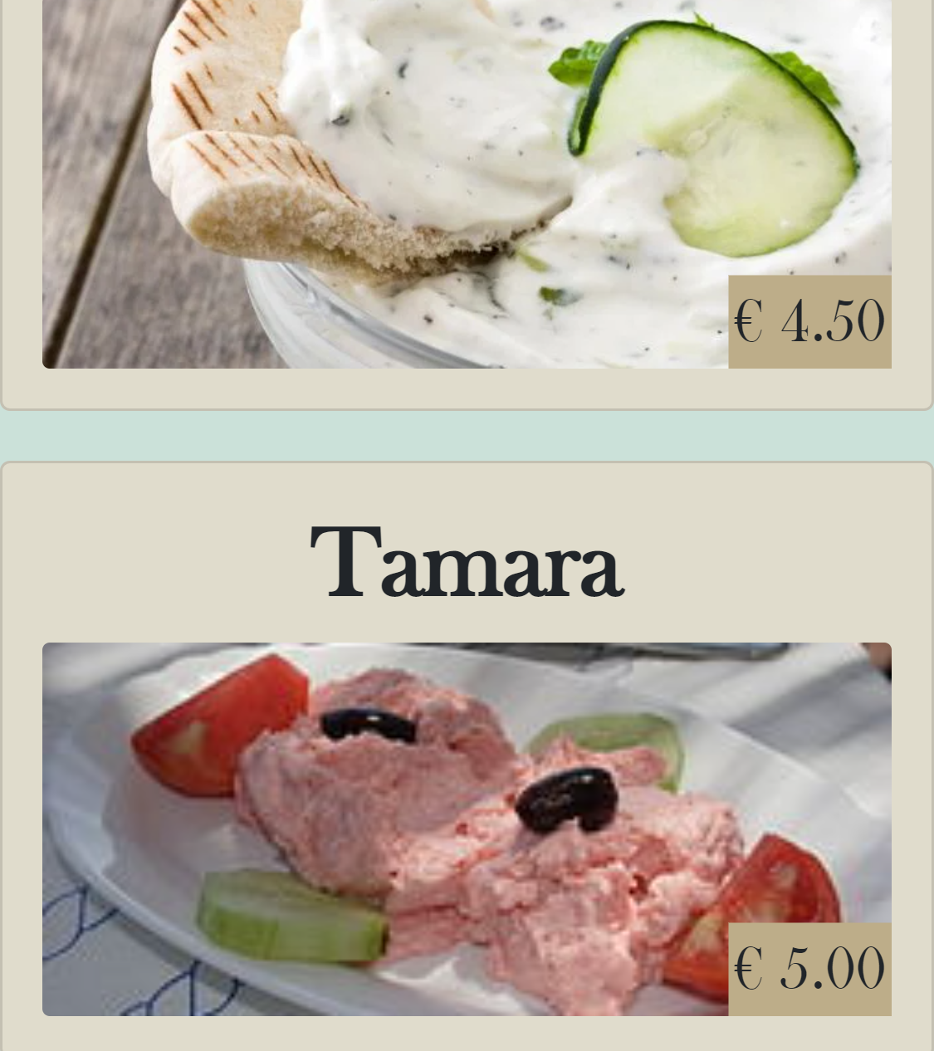
Customer App Sprint 5
Onderdeel van RigS

Slide 2

Inhoud
Afgelopen sprint
Transfer document
Final demo
Video

Slide 3

Afgelopen sprint
Combine group project to azure web services.
Bug fixing.
Finish documentation.
Transfer document.
CI/CD optimalization.

Slide 4

Transfer document

Slide 5

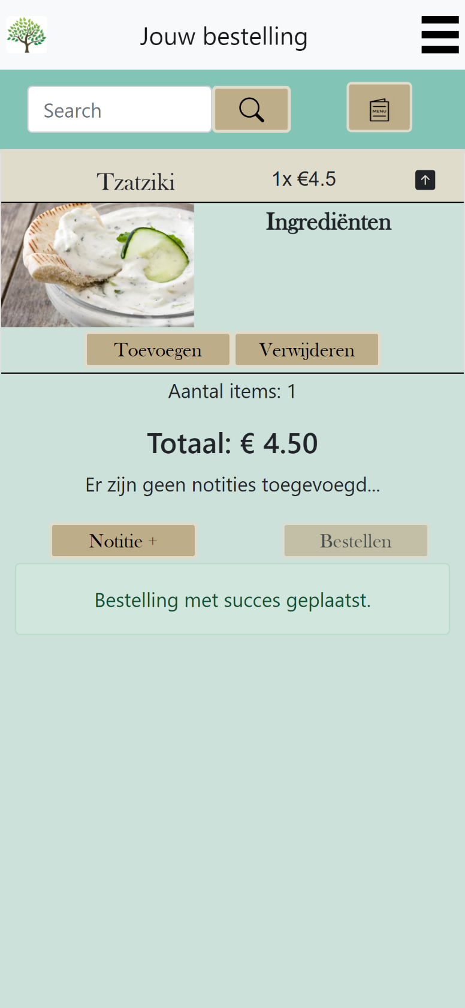
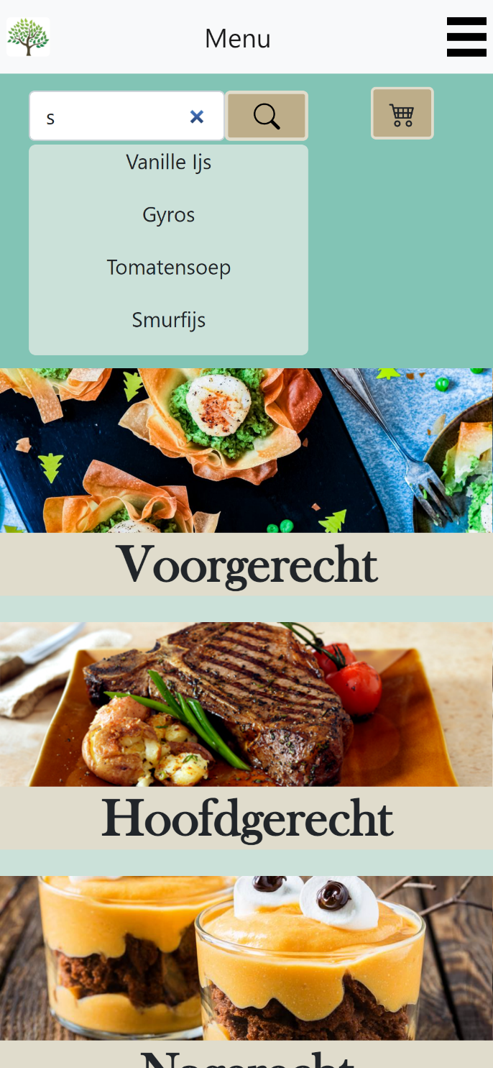
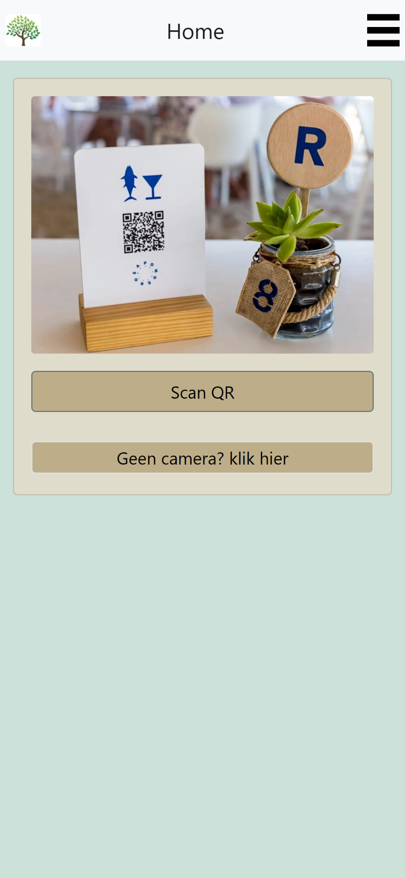

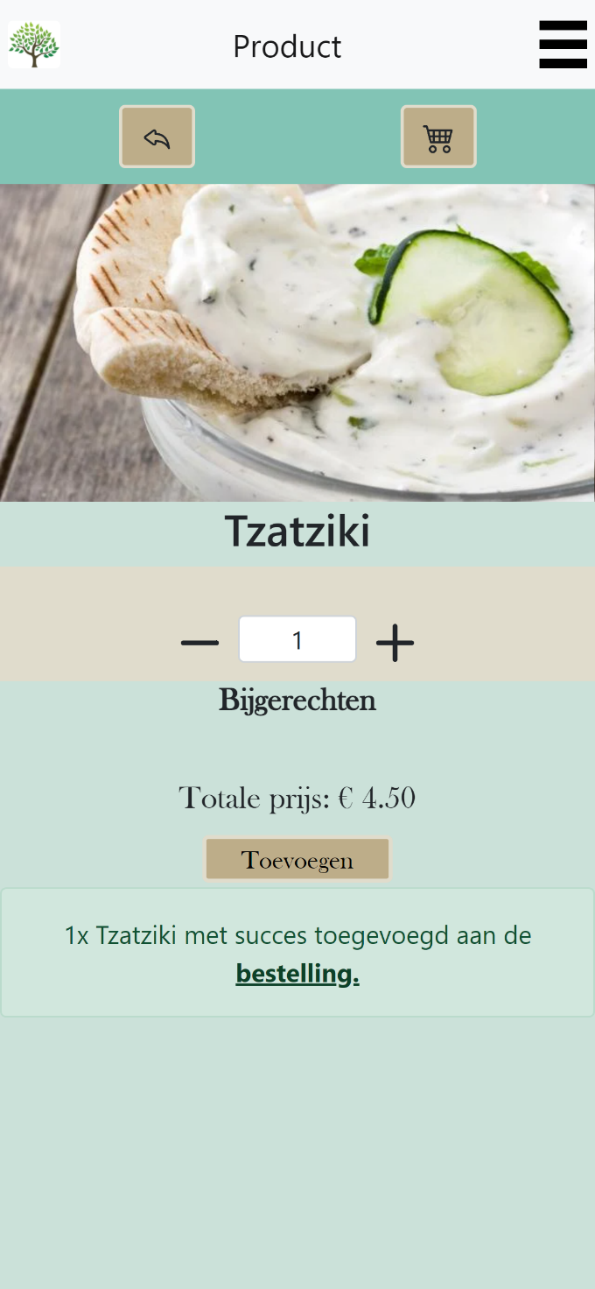
Final DEMO

Slide 6


